Slide 1

Heat Stress in Cattle
Keaton Herrmann
Washington Co. Agricultural Extension Educator

Slide 2
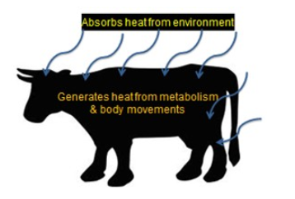
Heat Stress

Slide 3
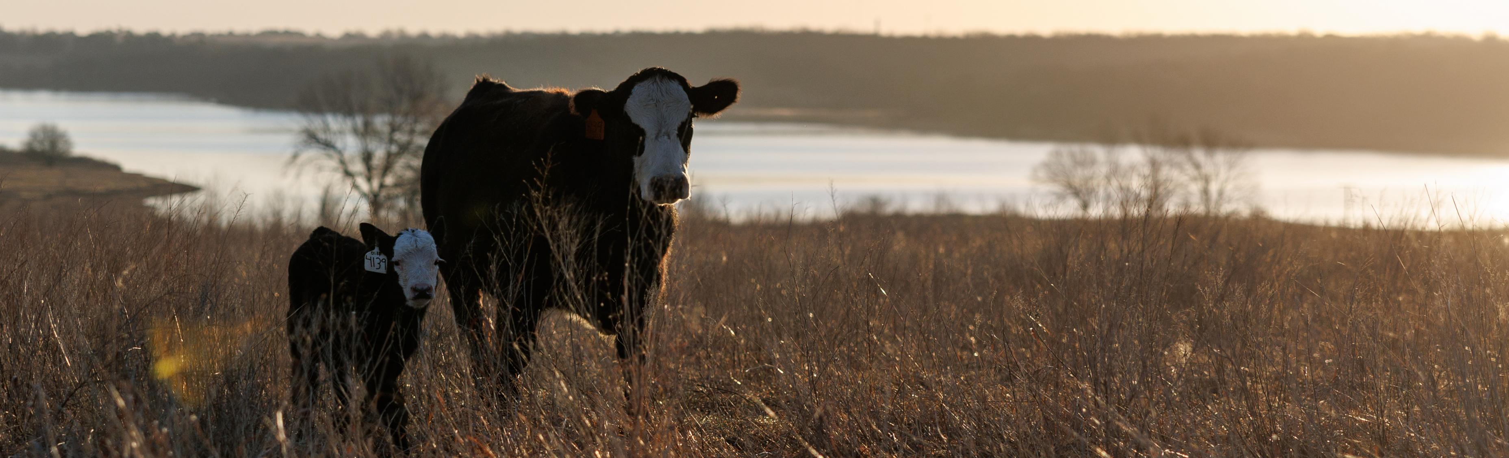
Heat Stress
Maps and Forecast
Oklahoma Mesonet
https://www.mesonet.org/
USDA Forecast Maps
www.ars.usda.gov

Slide 4
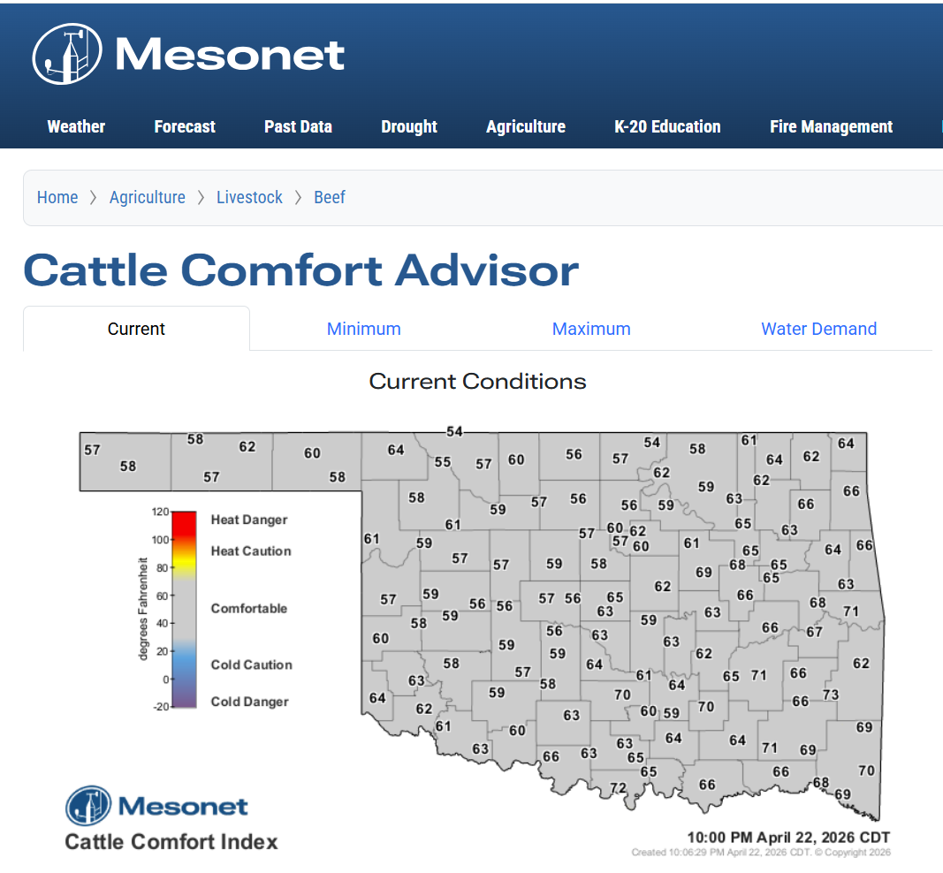
Heat Stress
Oklahoma Mesonet Cattle Comfort Index

Slide 5
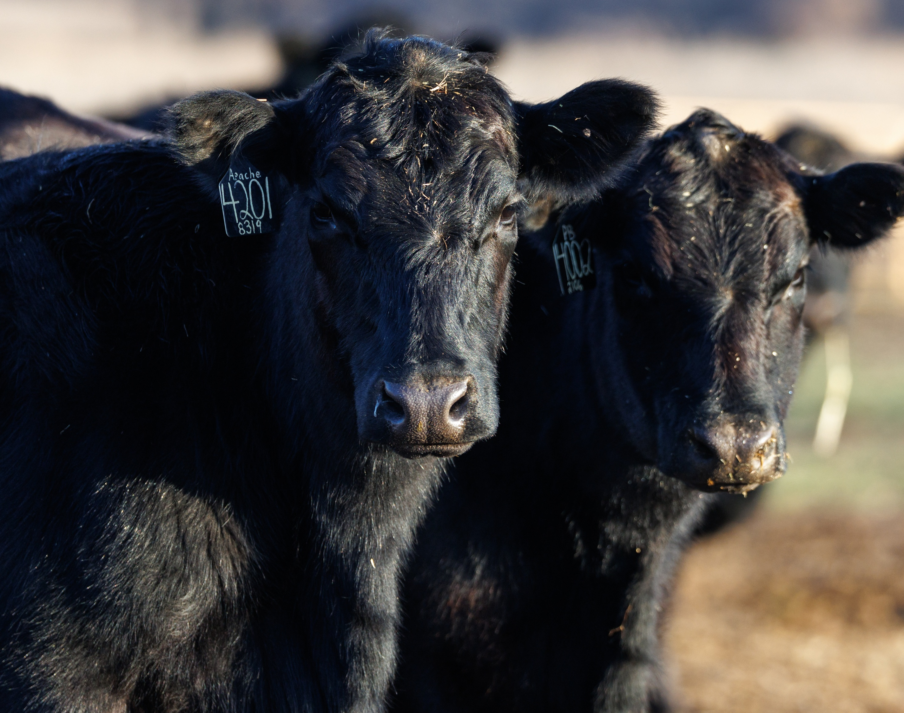
Heat Stress
Causes and Contributing Factors

Slide 6
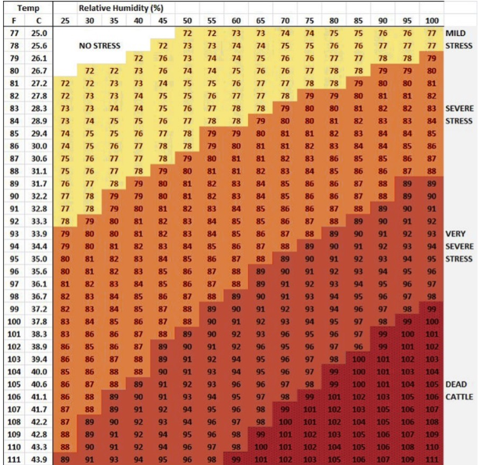
Heat Stress
Temperature and Humidity
Min. THI Threshold Heat Stress – 72
Max. THI Threshold Heat Stress – 99
https://extension.usu.edu/animalhealth/research/heat-stress-and-reproduction-in-beef-cattle

Slide 7
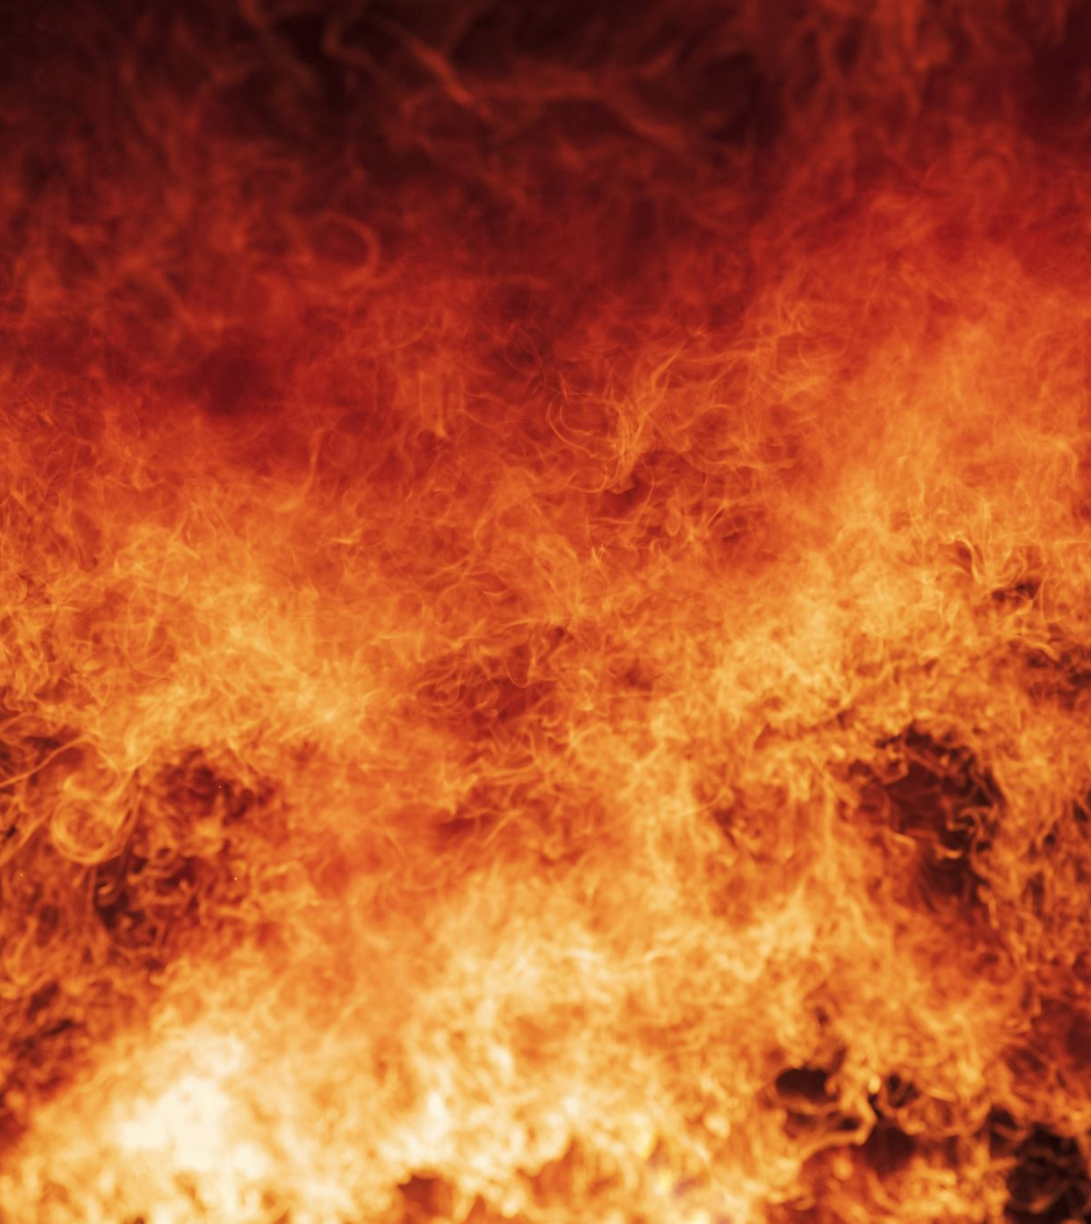
Heat Stress
Heat Load
Amount of heat needed to release to maintain a comfortable temperature

Slide 8
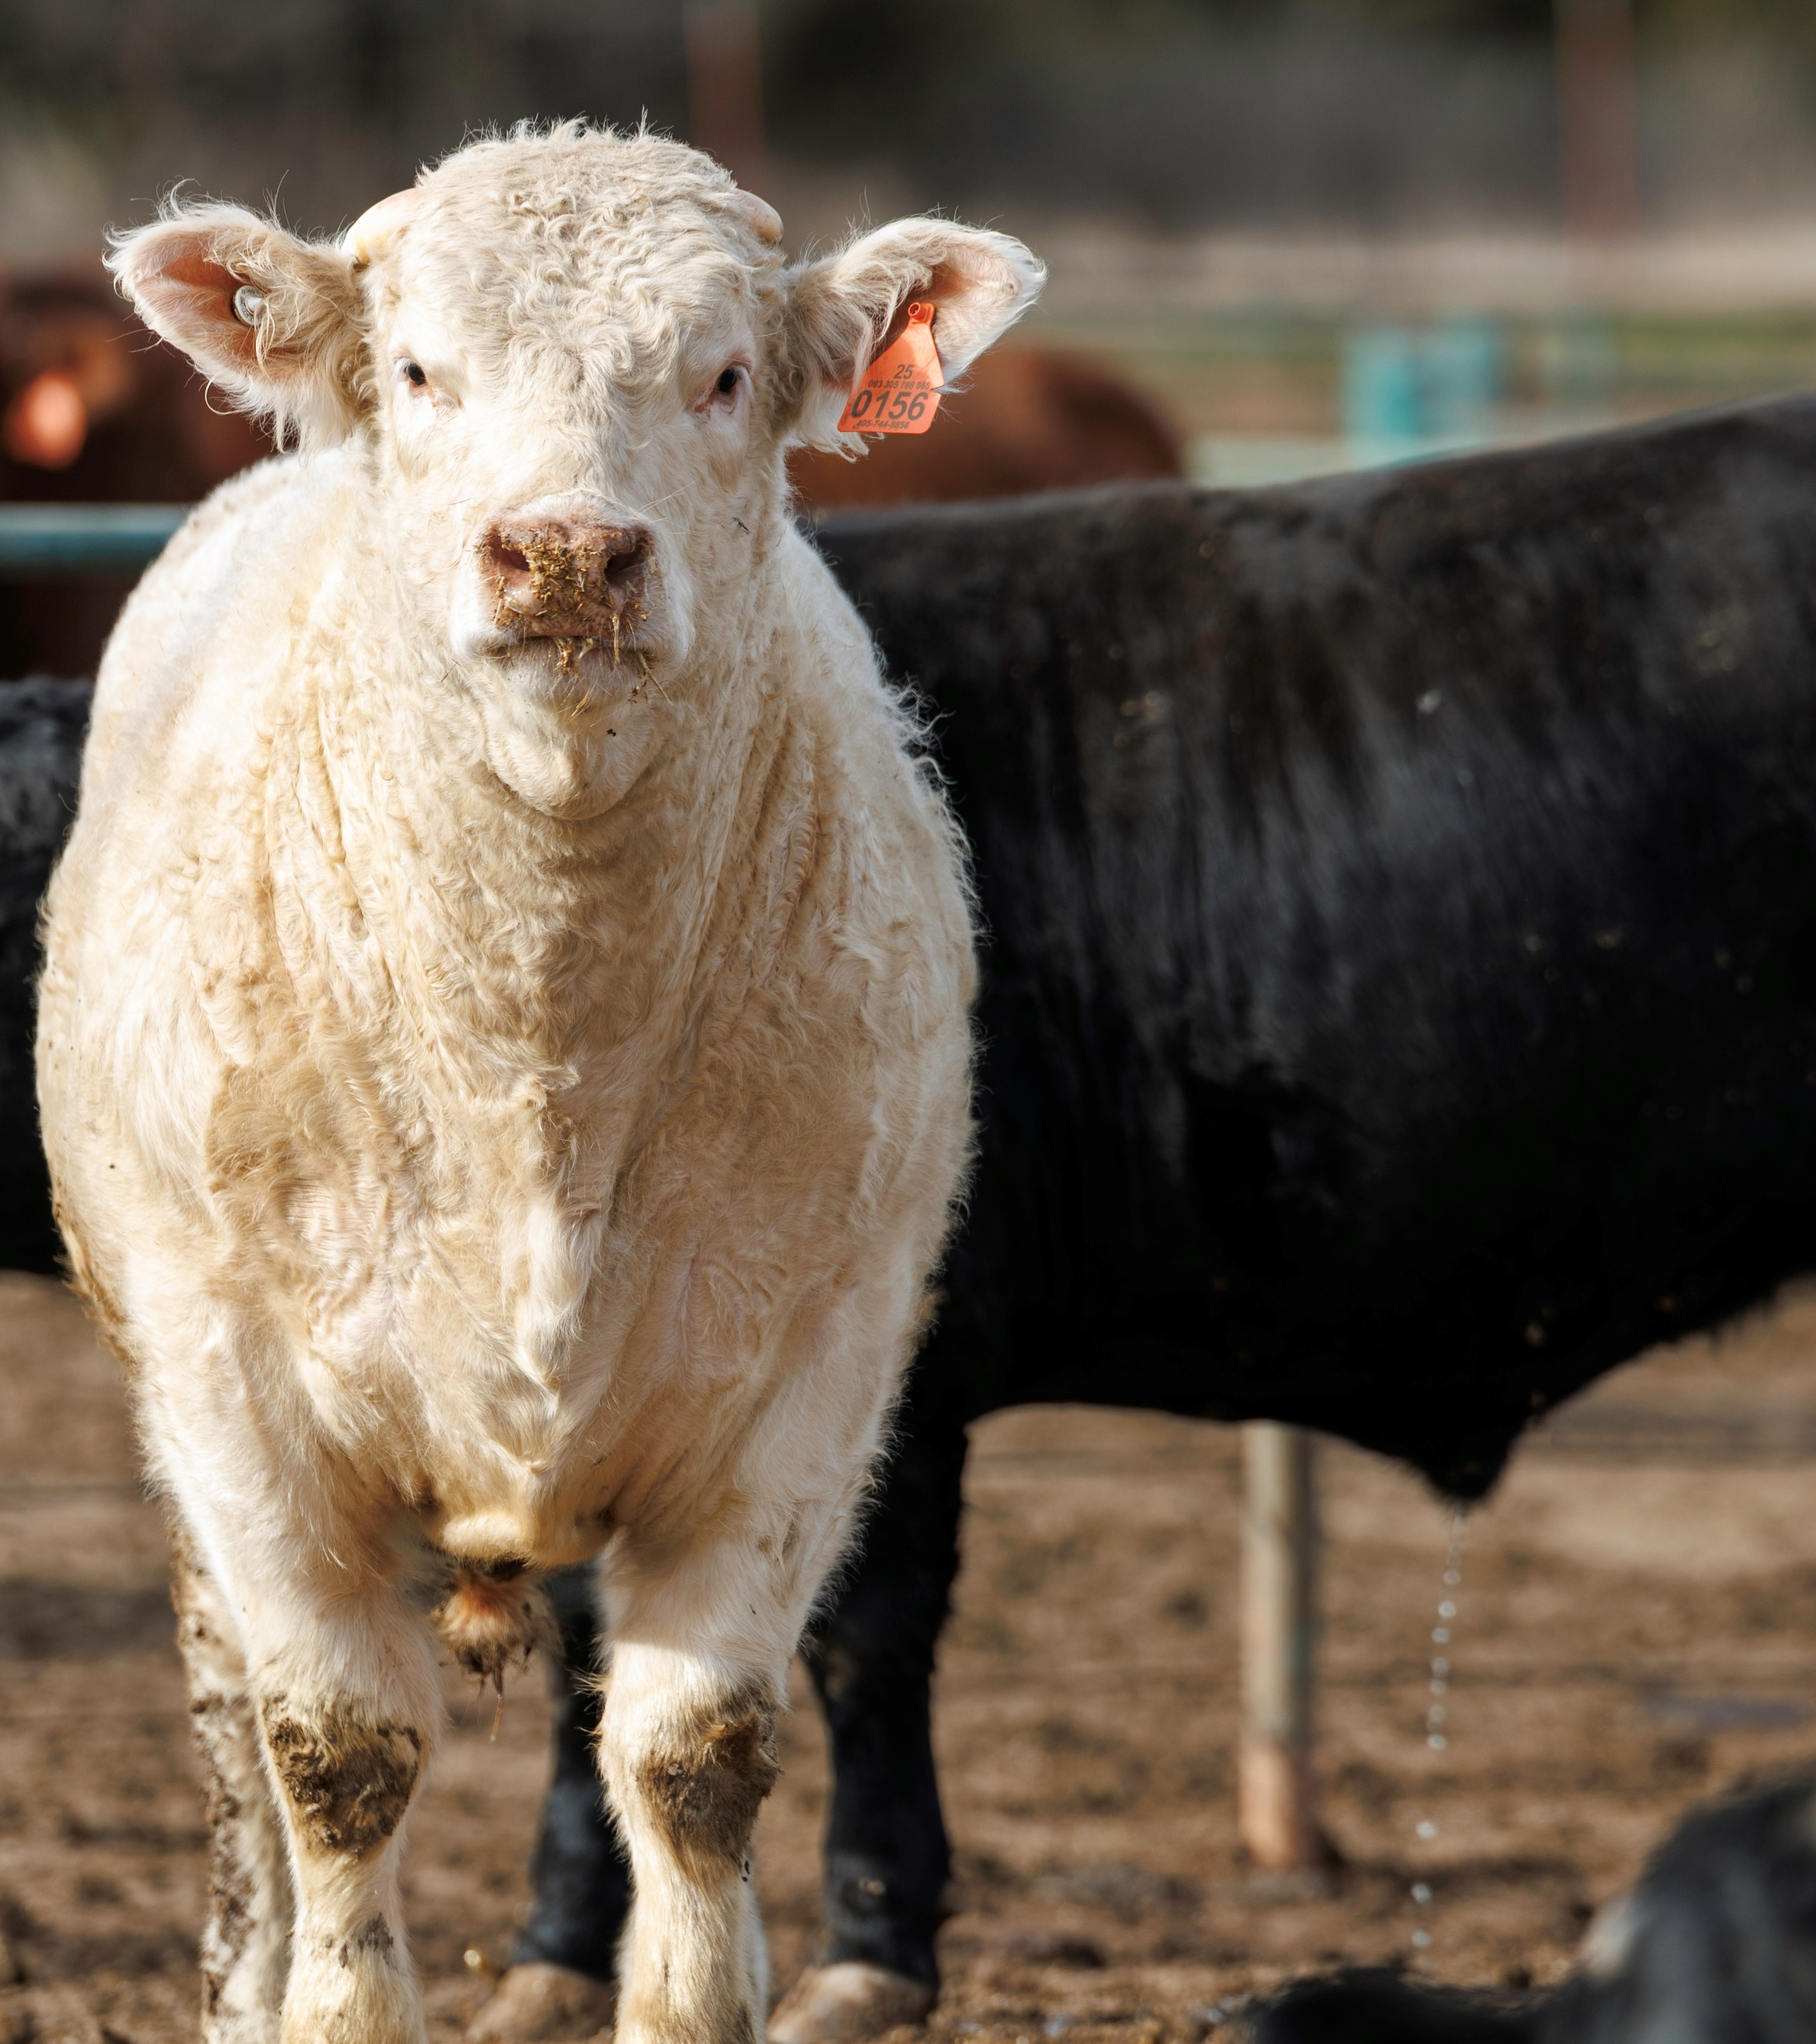
Heat Stress
Color of Hide

Slide 9
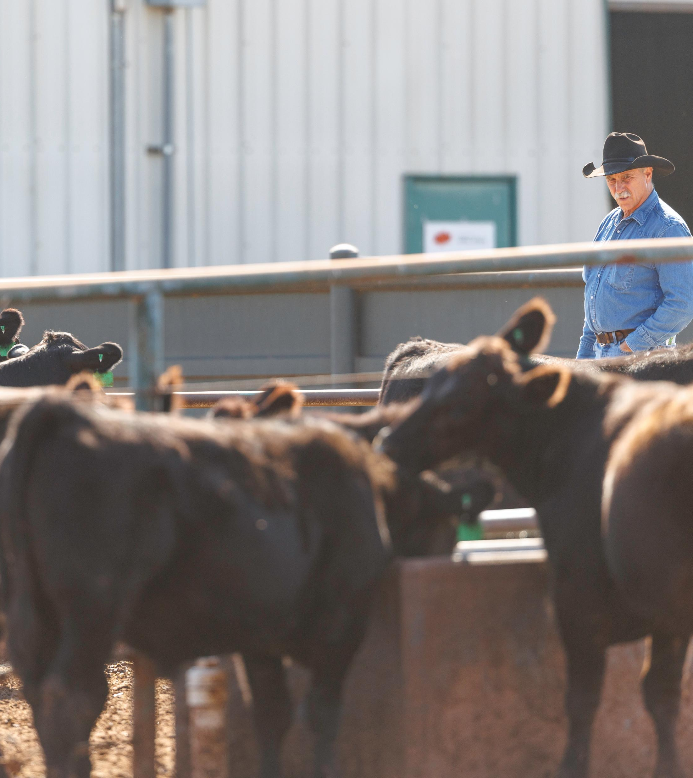
Heat Stress
Thermal Radiation
Limited access to shade or water

Slide 10
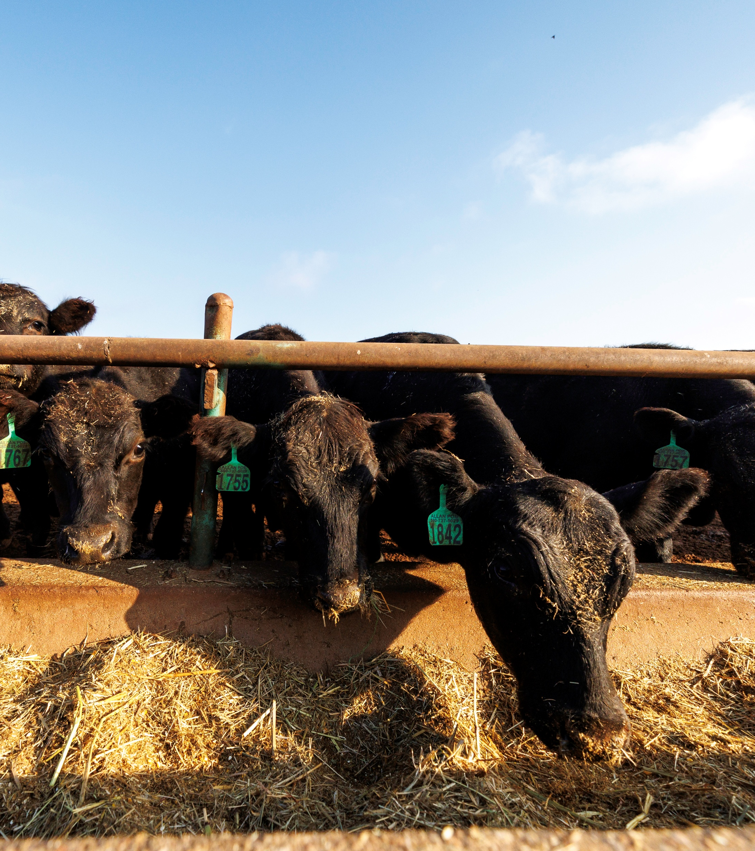
Heat Stress
Stocking Density

Slide 11
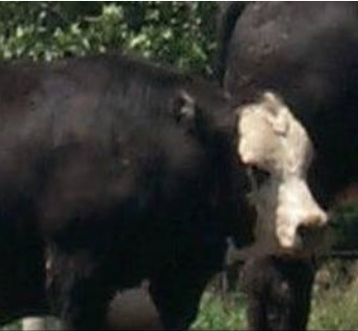
Heat Stress
Recognizing Heat Stress (www.ars.usda.gov)
Stage 1

Slide 12
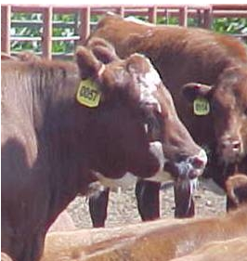
Heat Stress
Recognizing Heat Stress (www.ars.usda.gov)
Stage 2

Slide 13
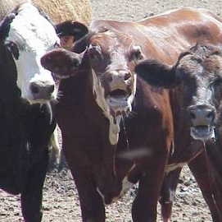
Heat Stress
Recognizing Heat Stress (www.ars.usda.gov)
Stage 4

Slide 14
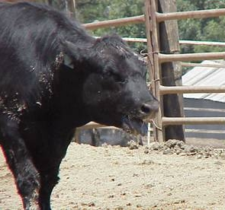
Heat Stress
Recognizing Heat Stress (www.ars.usda.gov)
Stage 6

Slide 15
Heat Stress
Temperature Effects on Dry Matter Intake

Slide 16
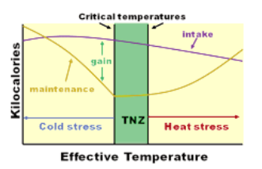
Heat Stress
Although DMI is decreasing, the animal’s maintenance requirement is increasing during heat stress

Slide 17
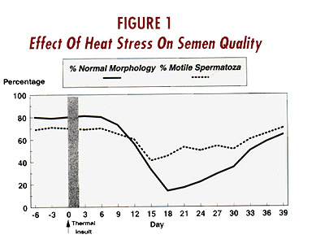
Heat Stress
Bulls
Prolonged heat stress can:
Impact quantity of sperm a bull produces
Cause a longer recovery time to normal levels of semen production
Reduce the bull’s libido

Slide 18
Heat Stress
Reproduction
Decreased luteinizing hormone (LH) in peripheral blood
Bull Mounts = summer 4.5 per estrus versus 8.6 for those in winter
Undetected estrous periods on a commercial dairy farm in Florida were estimated at 76-82% during June through September as compared to 44-65% during October through May
Decreases the flow of blodd to the uterus
Effects of heat stress have commonly been shown to carry over into subsequent months

Slide 19
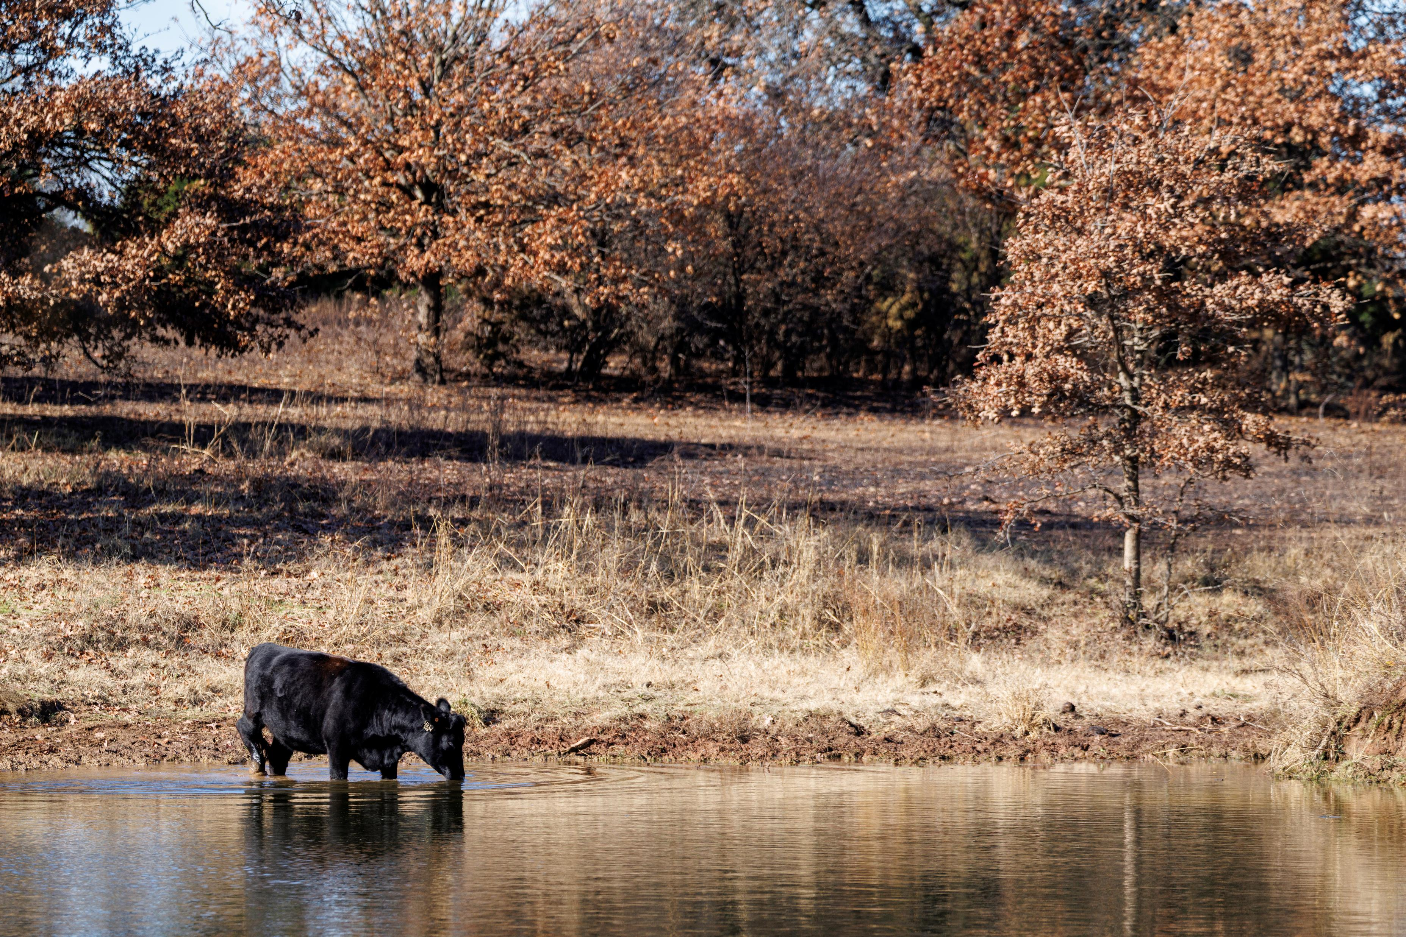
Management Considerations

Slide 20
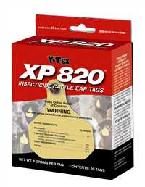
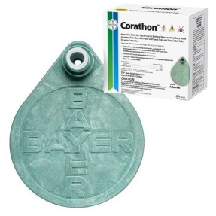
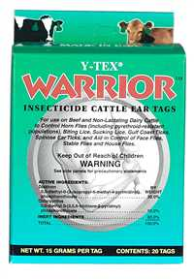
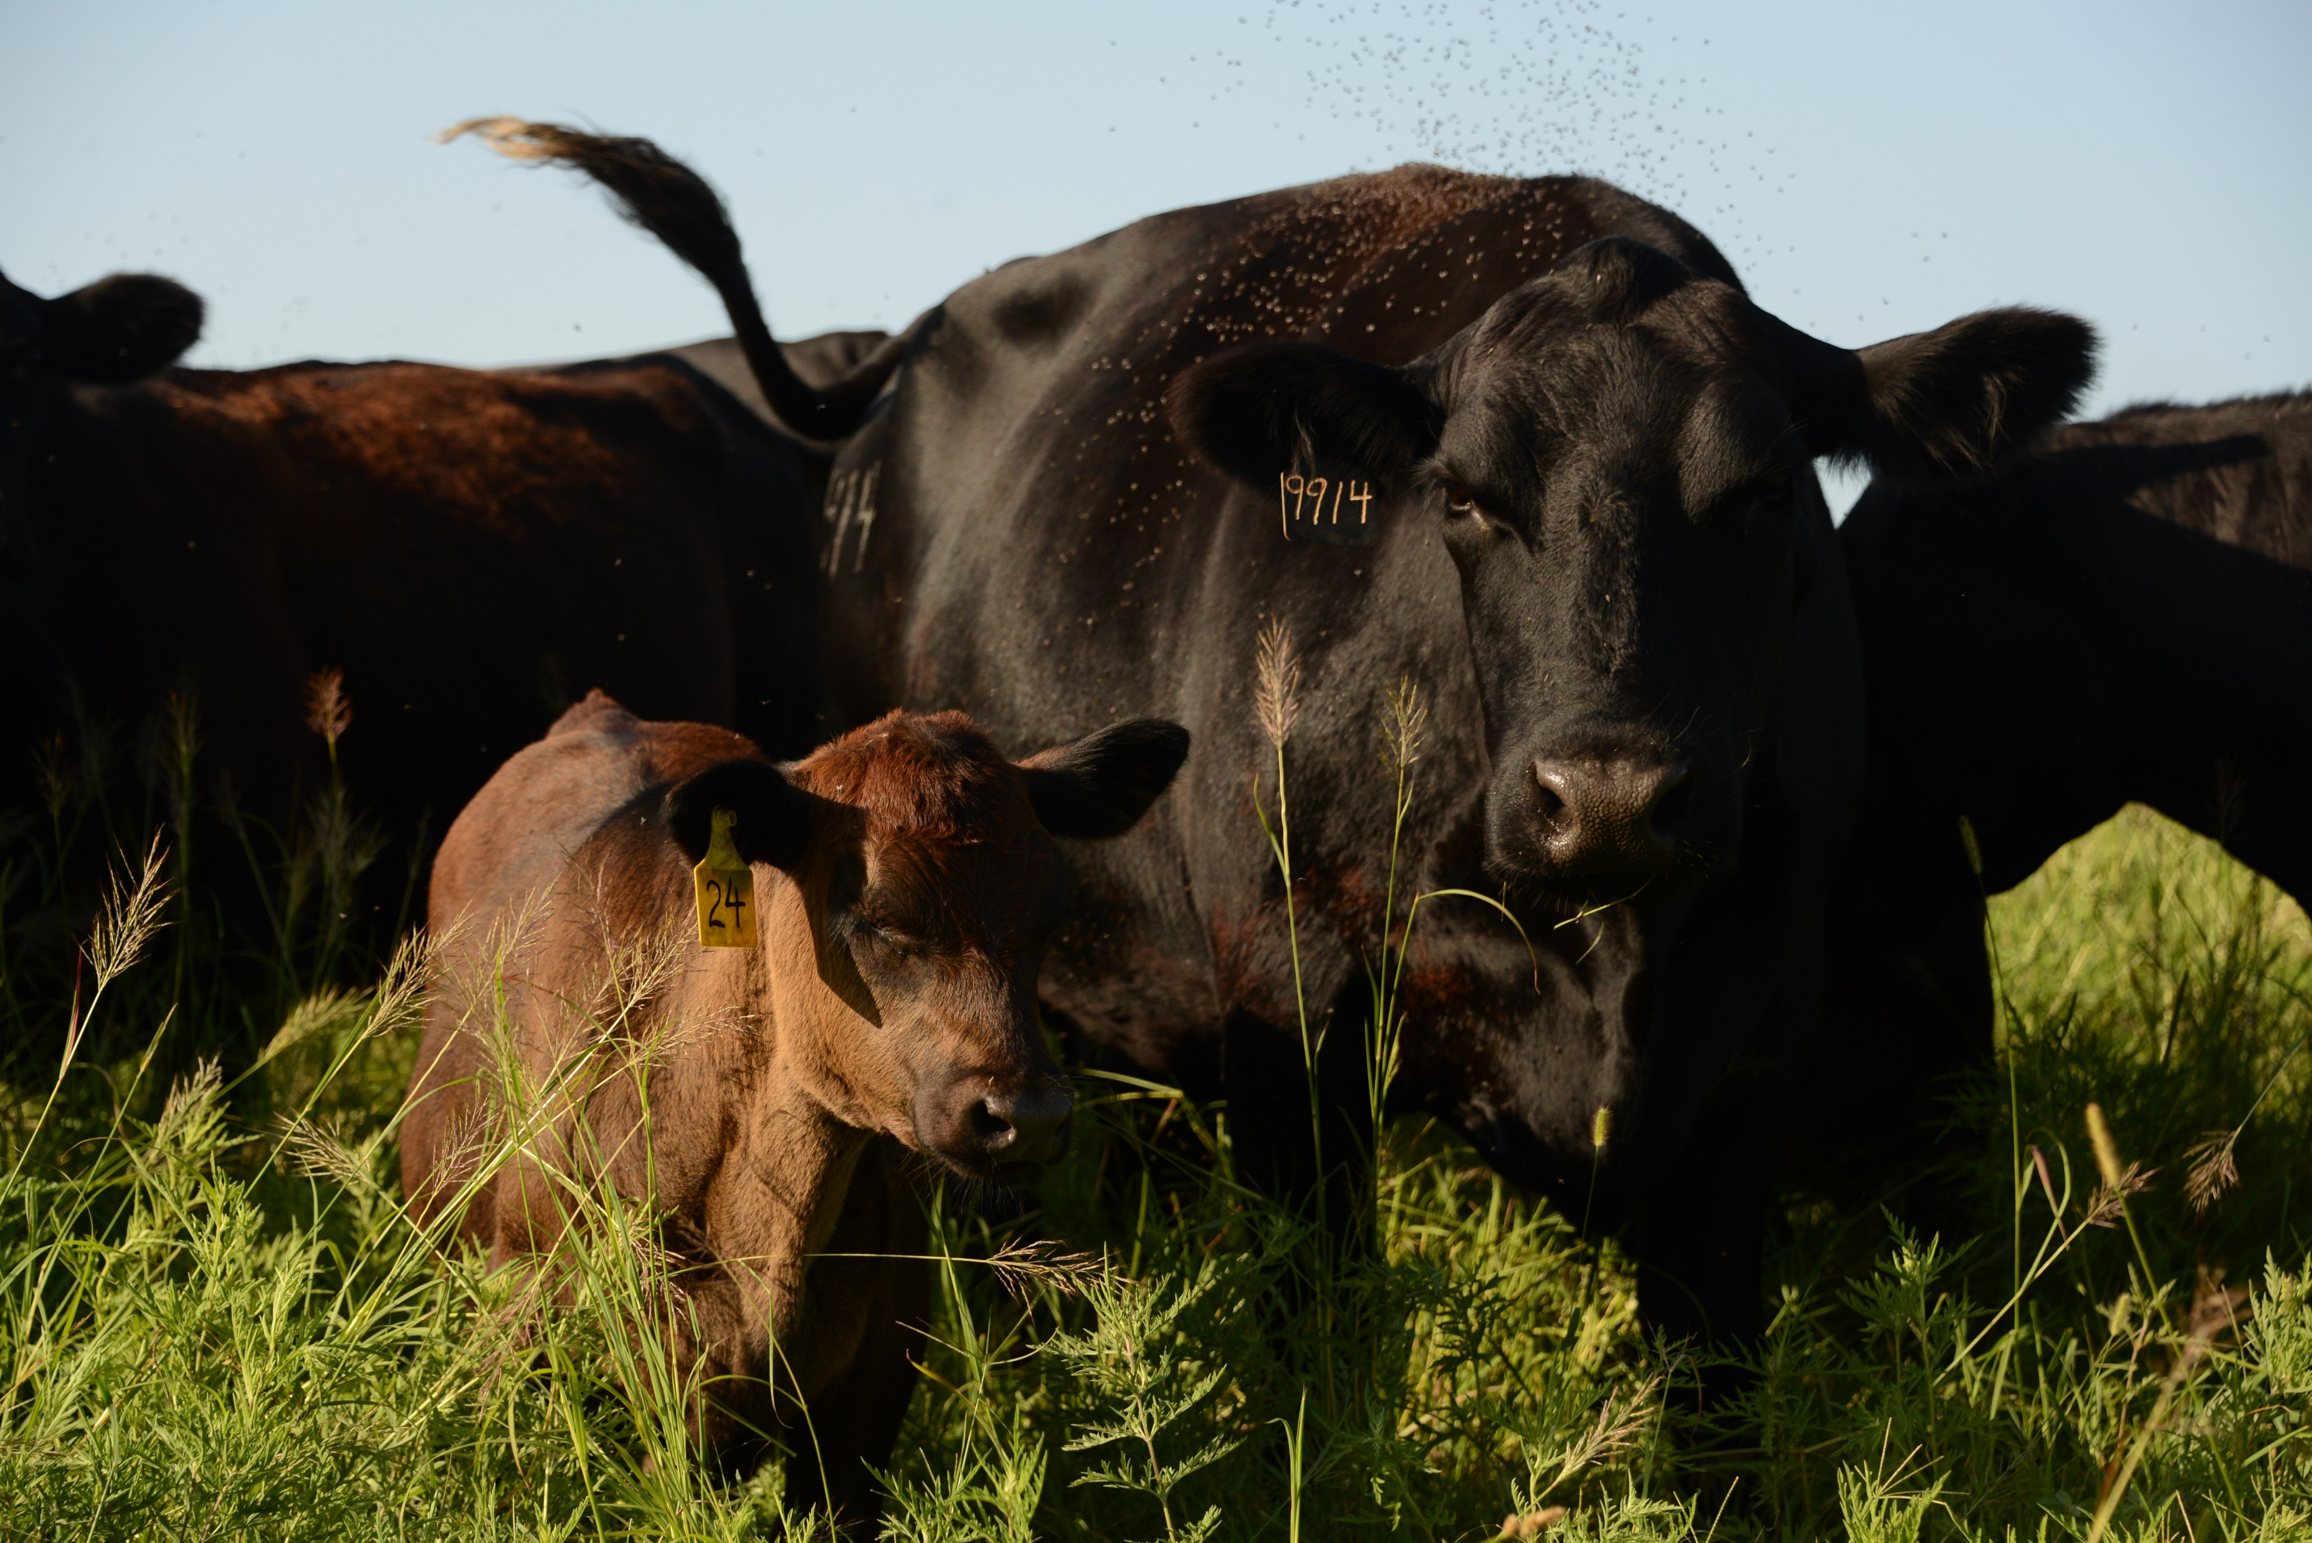
Management
Fly Control
Animals gather together to try to rid themselves of the flies

Slide 21
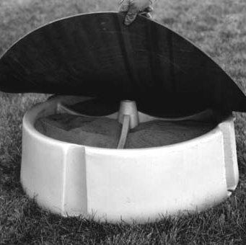
Management
Minerals
Higher water intake will increase urine production and subsequently increase losses of some minerals (sodium, potassium, and magnesium)
Possibly feed a vasodialator

Slide 22
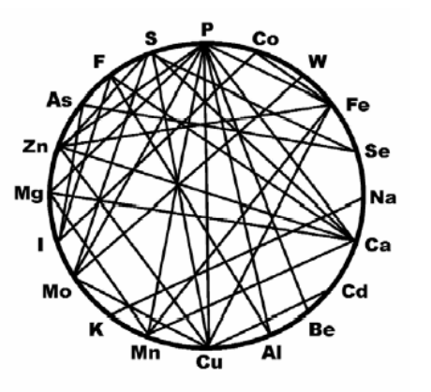
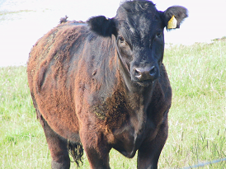
Management
Minerals
Copper Deficiency = hair retention

Slide 23
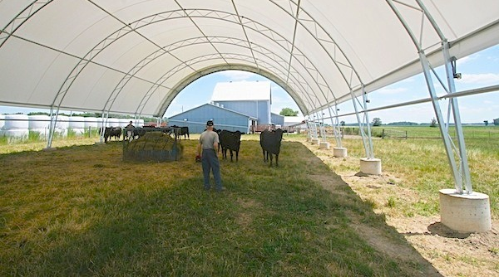
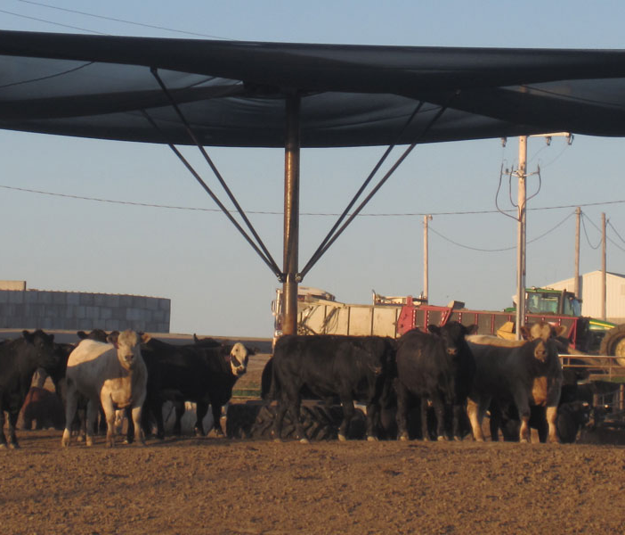
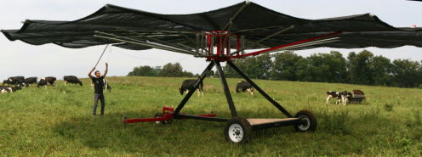
Management
Proper Shade

Slide 24
Management
Proper Shade
Portable 8 ft x 12 ft Shade with Metal Roof
Forage: both endophyte infected and endophyte free fescue
Most dramatic increase was on endophyte infected fescue

Slide 25
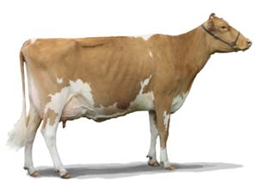
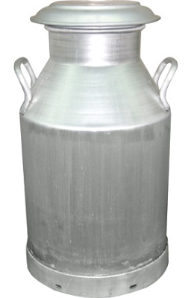
Management
Shade & Milk Production
Florida research on dairy = 10-19% ↑ with shade
Virginia Tech research = temps over 90°F can reduce milk production by 20-30% (10-25 lb of milk per day)

Slide 26
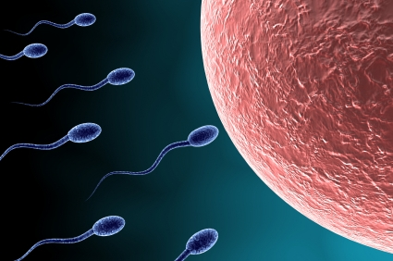
Management
Shade & Fertility
MO pregnancy rate:
Shade: 87.5%
No Shade: 50%

Slide 27
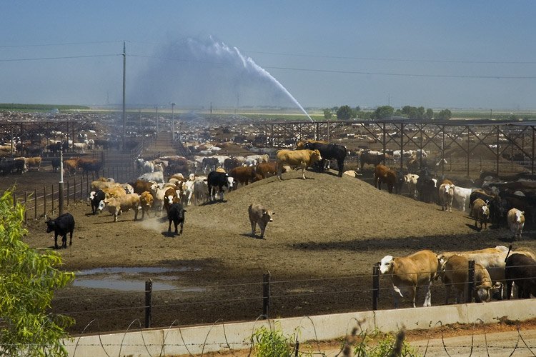
Management
Sprinklers
Use large droplets – not a mist
Wet the animals to the hide
Once you start with a sprinkler, continue until the heat wave is over
Consider multiple sprinklers
Avoid sprinklers around congested areas

Slide 28
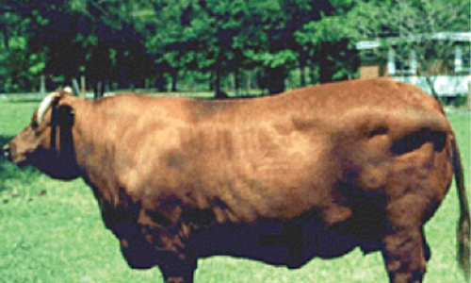
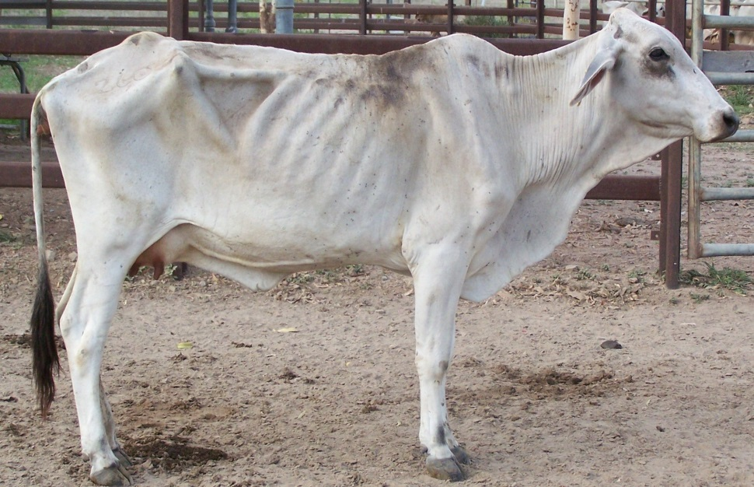
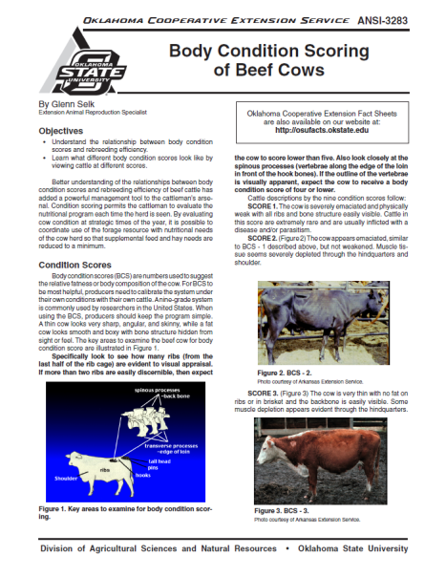
Management
Body Condition Score
Best Tool and Its Free
Use it to manage your herd’s nutritional needs

Slide 29
Review
Provide an abundant source of good, clean water
1
Take the offense on heat stress
2
Manage according to your operation
3

Slide 30
Oklahoma State University, as an equal opportunity employer, complies with all applicable federal and state laws regarding non-discrimination. Oklahoma State University is committed to a policy of equal opportunity for all individuals and does not discriminate based on race, religion, age, sex, color, national origin, marital status, disability or veteran status with regard to employment, educational programs and activities, and/or admissions.

Slide 31
Heat Stress in Cattle
Questions?
Keaton Herrmann
Washington Co. Agricultural Extension Educator

